Slide 1


ATNA Tooling
Gregorio Canal

Slide 2
What is the problem?
Right now the official Gazelle Security Suite (gss) holds the structure of the Audit Records defined in the IHE TF.
But it seems that the gss-audit structure has not been mantained aligned with current TF.
Moreover there is a chance to hold and mantain the Audit structure in one just one place and maybe also in an automated way.

Slide 3
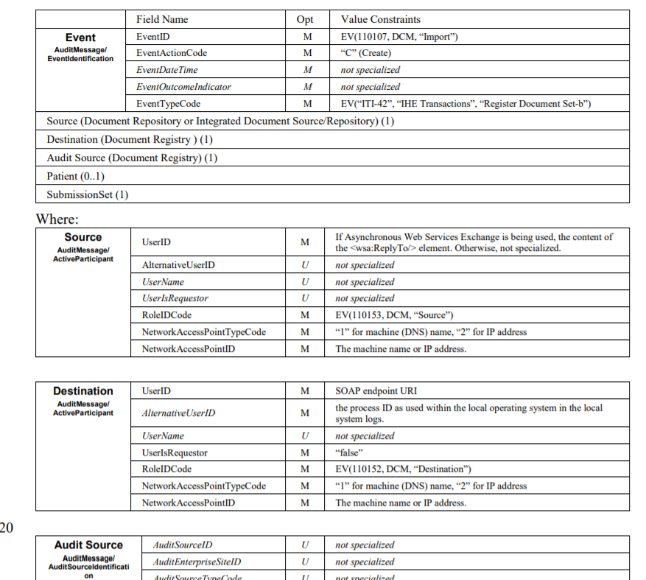
The Audit structure in IHE TF (1/2)
ITI-42 Registry Audit message

Slide 4
The Audit structure in IHE TF (2/2)
Right now the only way for the Technical Comitee to write constraints about an Audit message required for a transaction is to do it manually updating a table structred as we just saw.
Pros:
It can be done and updated easily
It can hold constraints that can be expressed by text
Cons:
It can’t be exported in a standard format

Slide 5
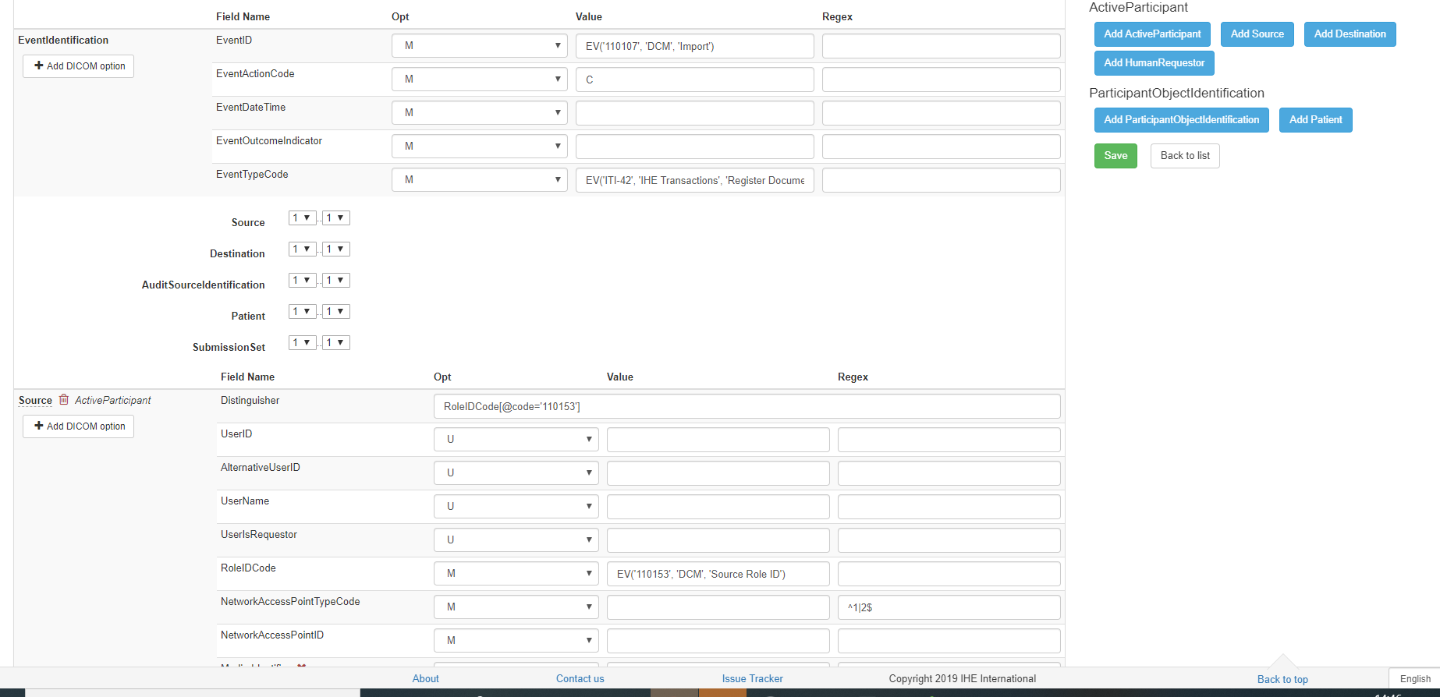
The GSS Audit structure - editing
ITI-42 Registry Audit message
GSS rendering

Slide 6
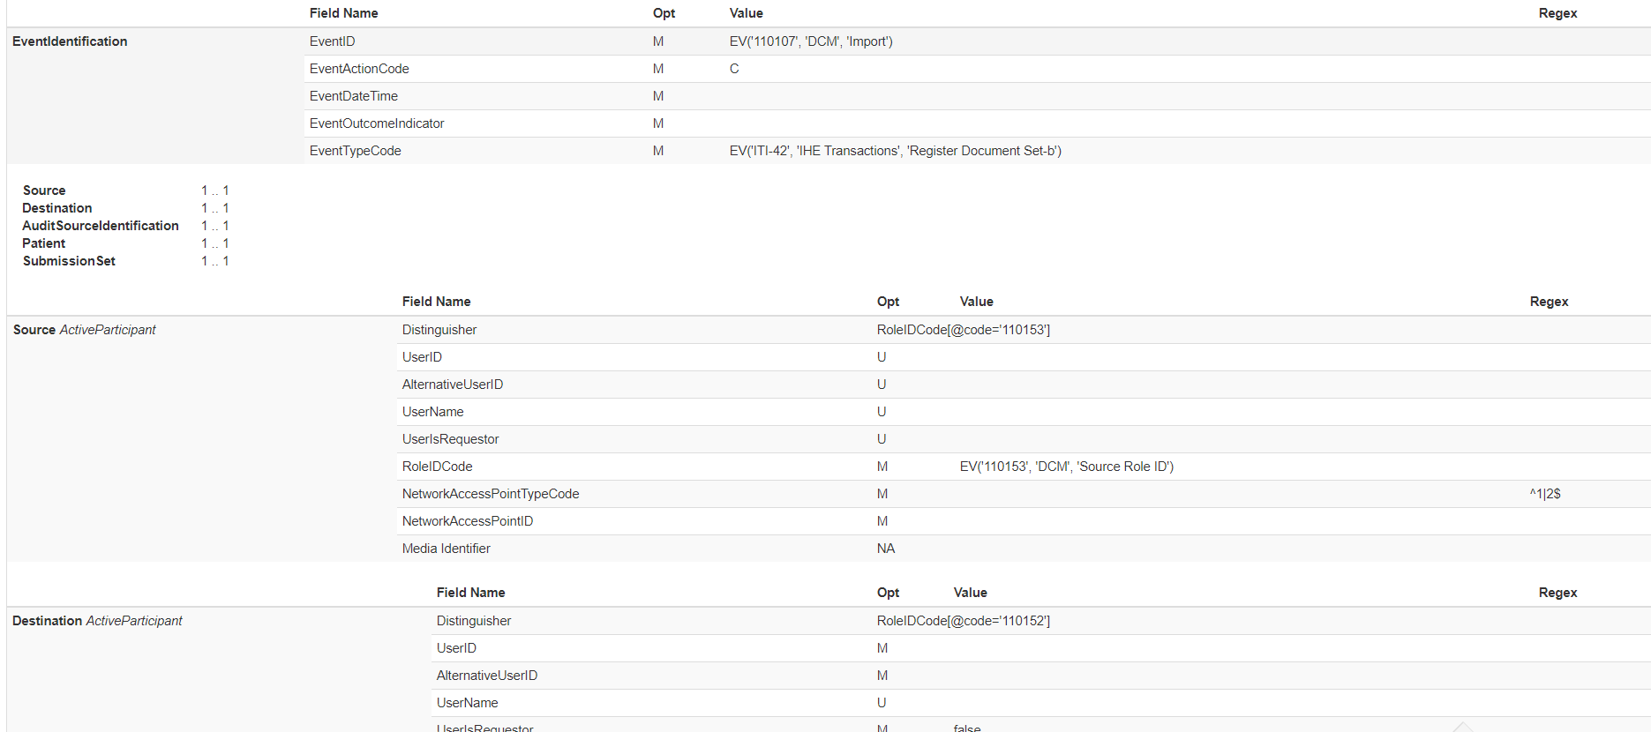
The GSS Audit structure - rendering
ITI-42 Registry Audit message
GSS rendering

Slide 7
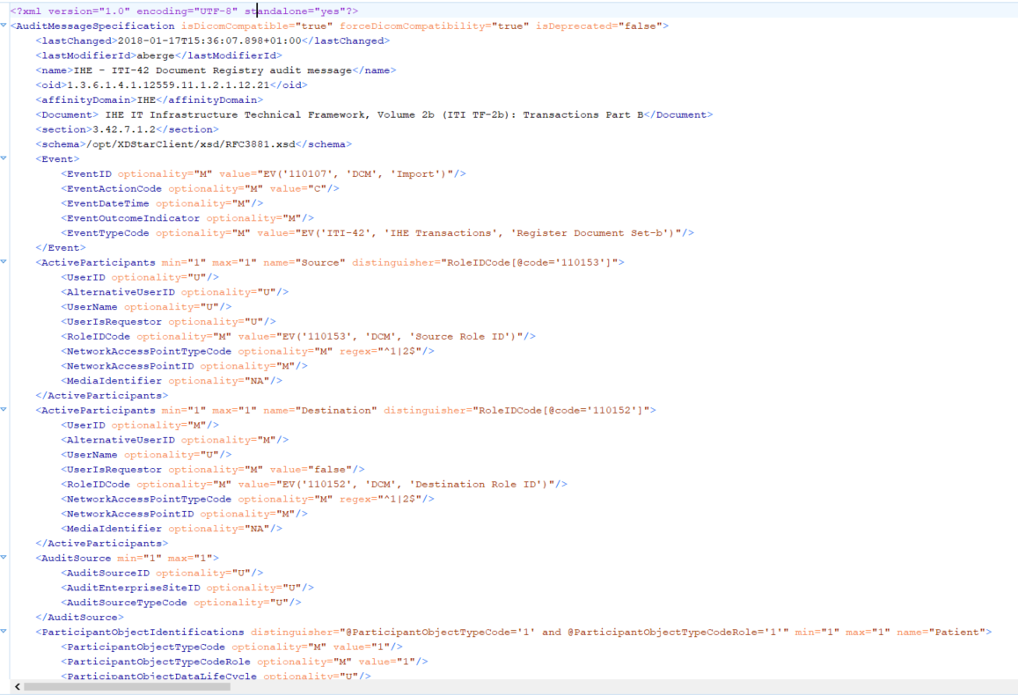
The GSS Audit structure - XML
ITI-42 Registry Audit message
GSS XML structure

Slide 8
The GSS Audit structure - summary
The primary reason because gazelle security suite host IHE-defined Audit structure is for testing. Those are used to implement validator in order to tests audit produced by vendors during Connecthatons.
Pros:
Gss has an easy write&edit UI for audit structure
Gss rendering of the audit structure is pretty similar on what is present in our TF
It is possible to upload or download an XML file that reflects the audit structure
Cons:
Right now gss audit it is not completly aligned with our TF and it is not easy to know what is not aligned
Some text constraints are/can not be reported in the current UI because can not be translated in a requirment to be tested
Any changes is not covered by a versioning system

Slide 9
Things to deal with
Which is the best place to store IHE defined audit messages
How constraints that can not be tested can be expressed in the gss-Audit structure
In order to mantain an alignment between gss and TF changing the owner of the official structure from TF to gss could be a solution. But what will we do with the ones in our TF? Should we replace the tables with gss URL or with the XML format?
A user that can access and update the gss audit structure is needed
A process to update or create new gss audit structure for future profiles.
FHIR publication tools?

Slide 10
Future work
First step: don’t add requirement to gazelle tools, but update TF in order to point to GSS → RMD profile taken in account
Second step: Make an ordered list about how the GSS tool should be updated (e.g. versioning, provide examples, add field for description, revision submitted by jira, status like draft or production as an alternative a dev environment, how handle future auditEvent messages?)

Slide 11
Phases
PH1:
ITI experimenting with GSS
PH2:
Involve QRPH and PCC
PH3:
Go global

Slide 12
Order List (1/3)
PH1
Add field for descriptive constraints (huge enough to hold long text)
Naming convention for ITI to experiment with tools
Using CP process with results recorded in jira for changes
Give admin permission to trusted editors
«How to» guideline for future phases
Outreach to ITI community explaining this change
At least one PC before moving to PH2

Slide 13
Order List (2/3)
PH2
Role feature for generic editing of audit structure
Add a «tag» to say this is defined (& can be updated only ) by IHE and currently referenced by TF.
Outreach to QRPH/PCC community explaining this change
At least one PC before moving to PH3

Slide 14
Order List (3/3)
PH3
Role that enables editing of IHE auditStructure
Add feature for valid examples
Better support to print or export the audit structure (stylesheet)
Improve naming conventions to a status (draft/normative) to AuditStructure or as an alternative a dev environment
Replace CP process with JIRA ticket (for changes to Audit)
Multiple values in the GSS value column
Versioning
Future auditEvent messages (lynn asked for a feature to translate audit stucture to an R4 auditMessage)

